Slide 1
Employee Attrition
Predictive Analysis:
To find out characteristics leading to attrition and identify any data points that can further help with analysis.

Slide 2
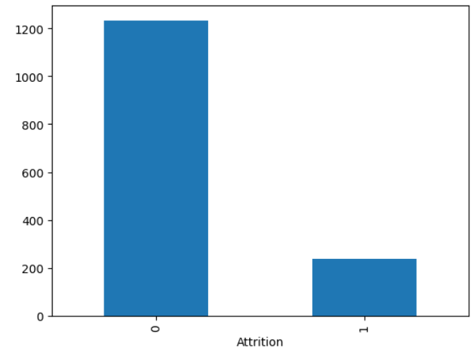
About the Data
We have, at our disposal, various Independent features which could potentially lead to Employee Attrition (Dependent), such as:
Age, BusinessTravel, DailyRate, Department, DistanceFromHome, Education etc.
About the Data:
There are various Categorical features which would need encoding.
Features have varying Scales, so we’ll need to perform Scaling.
Some features such as EmployeeCount, EmployeeNumber are not required as they have all/no unique values.
Also, some variables have already been encoded. We’ll drop them.
The data is highly imbalanced and contains majority of examples with “No Attrition” which would need synthetic Over sampling

Slide 3
Pipeline
Drop Columns which aren’t contributing to learning
Appropriately encode the categorical columns
Split the Data into Target and Independent columns
Synthetically over-sample the Data to balance out the classes (SMOTE)
Scale the Data (StandardScaler)
Train the model (LogisticRegression) and analyze the Metrics

Slide 4
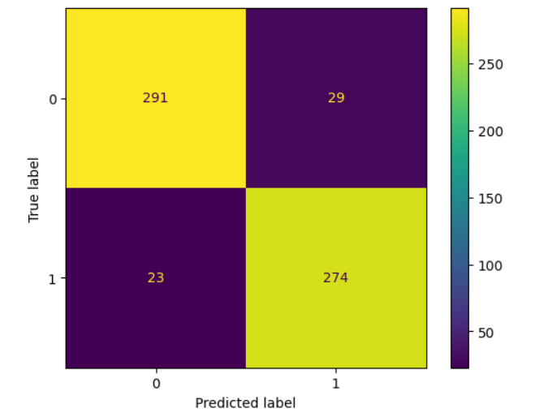
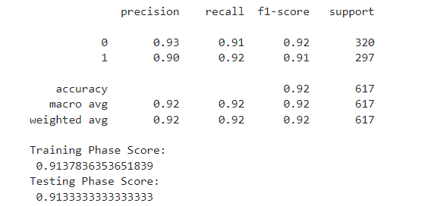
Model Performance
Logistic Regression performed well on both Training and Test set.
An accuracy and f1-score of ~90% looks good.
A Random Forest model was trained as well to draw conclusions about the relevance of features.

Slide 5
Conclusion
This has been a very interesting case study that can really help the HR team in analyzing which key areas to focus on for Employee retention.
Unfortunately, the Data was heavily biased towards the "No Attrition" Target values.
On top of that, there are certain features which have more values in a certain class, which seemed to prevent any concrete judgement, eg. less people work in HR/Sales compared to R&D. If we had almost similar number of examples for all these sub-classes, we would have gotten a more precise understanding of the nuances behind Attrition.
Overall, as things stand, the HR can take help of these findings and try to cater to below cases:
Try to appeal to the younger population, with opportunities to work in good Tech stacks (for eg.). Help them upskill, provide better hikes so they don't want to move out.
People in HR/Sales and people working in Labs are perhaps missing out on something which we need to cater to. Be it Job satisfaction, opportunities, Hikes etc.
The Company is doing good with Gender distribution so keep at it.

Slide 6
Next Steps
To help further with the analysis, we can take care of below points:
We should try to acquire more natural Data for the "Yes Attrition" class.
Try to gather balanced data for all Departments, be it HR, Sales, R&D and all roles as well. Looking at majority of examples in Life Sciences, I cannot say for sure if Attrition is more due to more number of workers, or more due to an underlying issue that needs to be addressed. Because, obviously, 50 people leaving out of 100 is not the same as 50 people leaving out of 1000. We need more balanced data covering all variations.
If we can get our hands on more features such as Ongoing Mortgage payments/Loans (If someone has a Loan to pay off, they'd prefer to get a higher package soon), Family type (Employees would prefer working closer to home if they have old Parents living with them), Mapping of skills to Projects (a person would prefer working on a Project where his skills are being properly utilized), Overall Employee Friendliness Quotient of the company etc.
Few columns are inter-dependent, we can do away with some of them and try to get features which can uniquely identify the Target.

